Slide 1
CSE 2451 Manual Memory Management
Zichen Zhang

Slide 2
Overview
Revisiting sizeof operator
Revisiting a C program’s address space
Dynamic memory allocation
stdlib.h
malloc()
calloc()
realloc()
free()
Memory leak
Brief introduction on Valgrind Memcheck

Slide 3
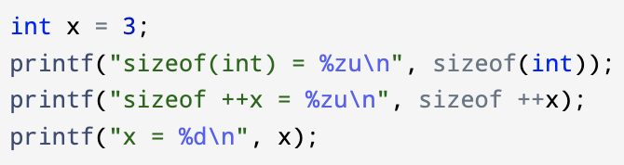
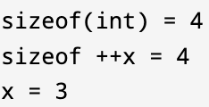
sizeof operator
sizeof operator, syntax
sizeof is a compile time operator, it doesn’t evaluate its operand (expression)
sizeof returns the size of its operand in terms of number of bytes
sizeof return a non-negative integer value of size_t type
size_t is an unsigned integer type
used to represent size of an object
commonly used to declare variable for array indexing
Its range is guaranteed to be big enough to contain the size of the largest object the host system can handle
%zu is the format specifier for size_t values
You can print size_t type values with %d or %u but when the actual value stored in size_t typed variable exceeds the range of int or unsigned int, the printed value is not correct
sizeof (type)
sizeof expression
Notes:
Pointer arithmetics:
https://www.geeksforgeeks.org/pointer-arithmetics-in-c-with-examples/

Slide 4
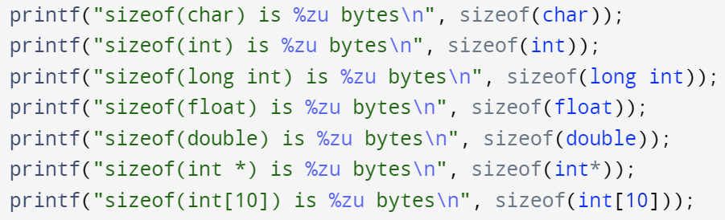
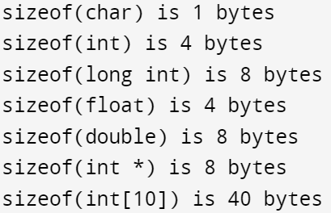
sizeof operator - example
Using sizeof with type keyword: need ()

Slide 5
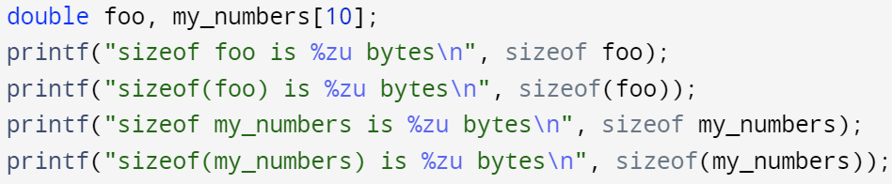
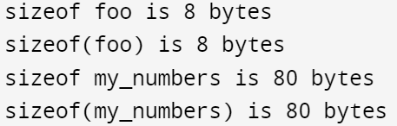
sizeof operator - example
Using sizeof with expression: () is optional

Slide 6
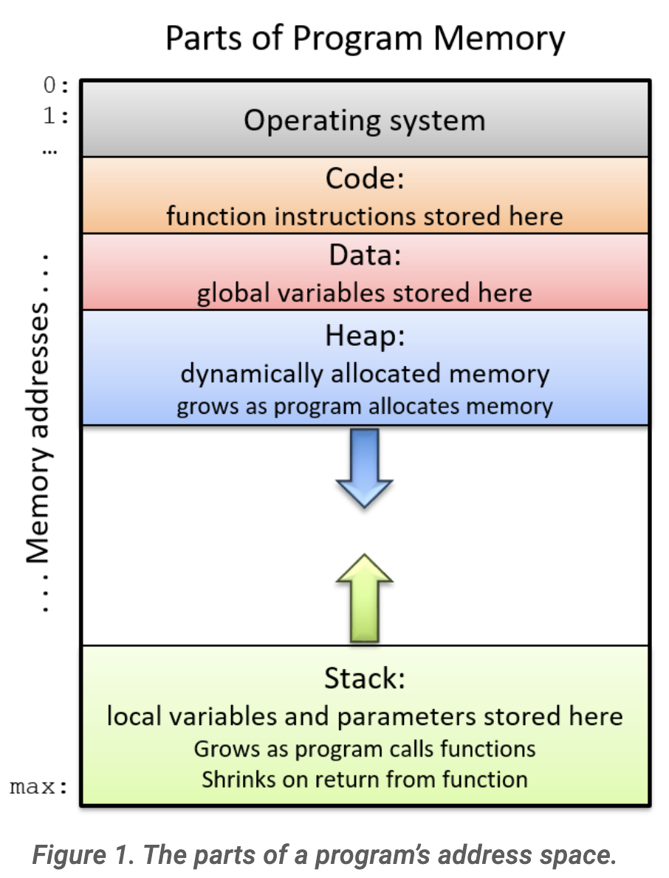
C program’s address space
Data segment
Initialized global variables
Uninitialized global variables (bbs, block started by symbol)
Heap segment
Dynamic memory allocation
Starts at the end of bbs, grows towards stack segment.
Stack segment
local variables
On the standard PC x86 computer architecture, it starts at the high-end of memory address for the program and grows toward address zero; on some other architectures, it grows in the opposite direction.
An extra segment storing the command-line arguments and environment variables
Have higher address than the stack segment (not shown in the figure on the right)
Initialized global variables
Uninitialized global variables (bbs)
Command-line arguments and environment variables
Image source: Suzanne J. Matthews, Tia Newhall, Kevin C. Webb, ”Dive into Systems”
Notes:
Virtual memory and heap:
https://www.cprogramming.com/tutorial/virtual_memory_and_heaps.html

Slide 7
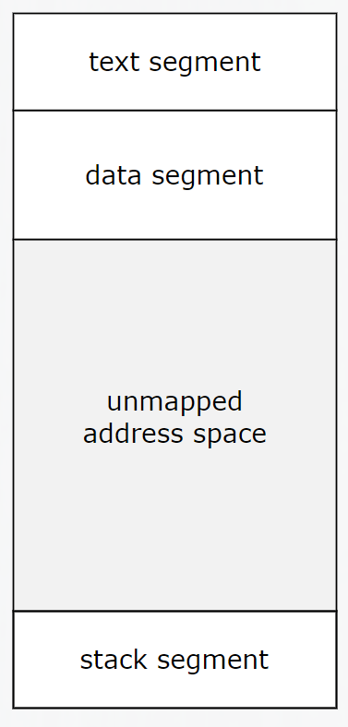
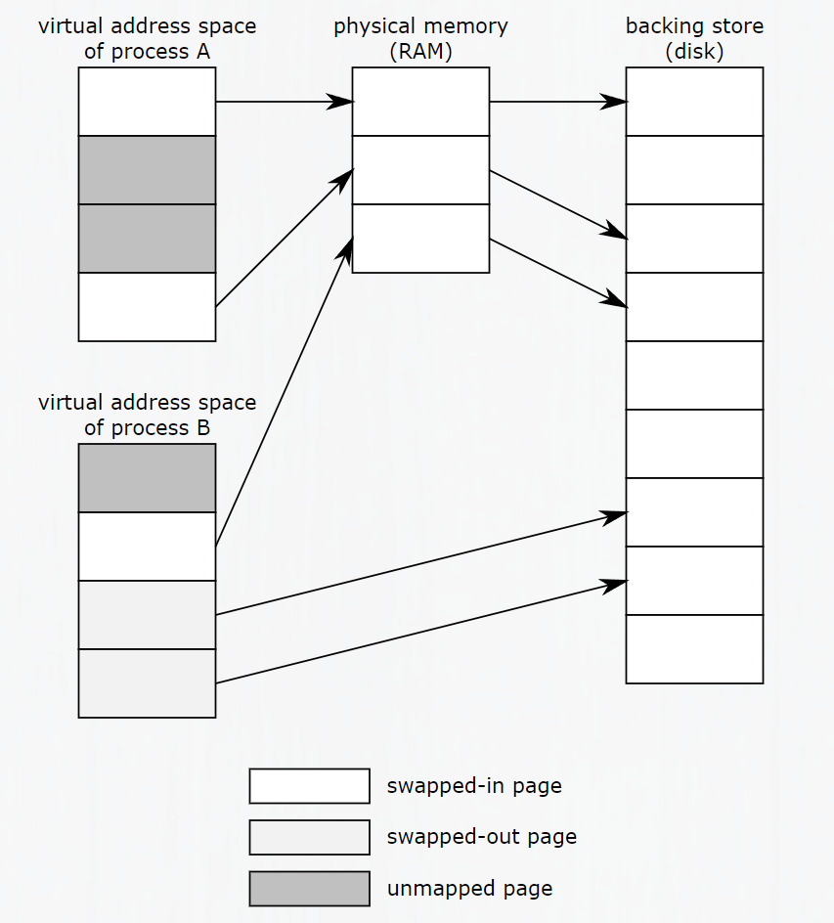
C program’s address space
The memory / address space of a program typically use a virtual memory space nowadays
An address in a program’s address space is not the address of the physical memory, but a mapping of physical memory address into the virtual memory address space (program address space)
A 64-bit processor -> a pointer of 64 bits -> This pointer can address 2^(64) bytes of memory, that is more than 1.8*10^10 GB of memory, we don’t really have this much RAM + disk storage in our computer
Heap segment is managed by a heap memory manager
When the heap segment grows, the heap manager maps more available physical memory address into the program’s address space (the virtual address space)
When the heap segment shrinks, the heap manager “release” previously occupied physical memory for other process to allocate
Virtual memory
Consecutive blocks of memory in the program’s address space may be fragmented in physical memory space (there are optimizations on different stages try to avoid this, but it’s not guaranteed)
Heap segment
grows
(virtual) address space
Image source: “Memory Management Reference”
Notes:
Heap manager:
https://stackoverflow.com/questions/72104841/virtual-memory-and-heap
https://www.ibm.com/docs/en/i/7.2?topic=memory-heap-manager
https://www.cs.princeton.edu/courses/archive/spring08/cos217/asgts/heapmgr/#:~:text=A%20standard%20C%20programming%20environment,heavily%20in%20many%20C%20programs.

Slide 8
Dynamic Memory Allocation
C provides methods to manually manage the memory
We can allocate the memory we use, and deallocate/free it when we’re done in a dynamic fashion
Such dynamic memory allocation allows a C program to request more memory as it’s running, and a pointer variable stores the address of the dynamically allocated space.
Dynamic memory allocation grants flexibility to programs that:
Do not know the size of arrays or other data structures until runtime
Need to allow for a variety of input sizes (not just up to some fixed capacity, efficient memory usage)
Grow or shrink the sizes of the memory allocated as the program runs
Dynamic memory allocation is flexible, but mistakes can cause:
Memory leaks
Crashes
Heap corruption
Other undefined behaviors

Slide 9
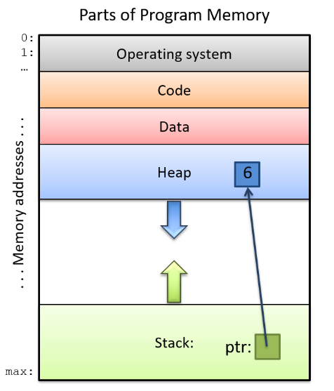
Dynamic Memory Allocation
C provides functions in the standard C library stdlib to allocate and deallocate memory
Example on the right shows
A local pointer ptr
ptr stores address of a block of allocated memory in the heap segment
Actual value stored in the heap segment is integer 6
Image source: Suzanne J. Matthews, Tia Newhall, Kevin C. Webb, ”Dive into Systems”

Slide 10
Dynamic Memory Allocation
You need to #include <stdlib.h>
void * malloc(size_t size);
void * calloc(size_t nmemb, size_t size);
void * realloc(void *ptr, size_t size);
All the above 3 functions returns:
Returns a void pointer type value
The returned value stores an address within the heap segment
The returned address is the starting memory address of the allocated memory block
Returns NULL if allocation fails (no more memory block of specified size to allocate)
void free(void * ptr);
deallocates dynamically allocated memory block
ptr stores an address returned by malloc/calloc/realloc
You need to pair each malloc()/calloc() with a free()

Slide 11
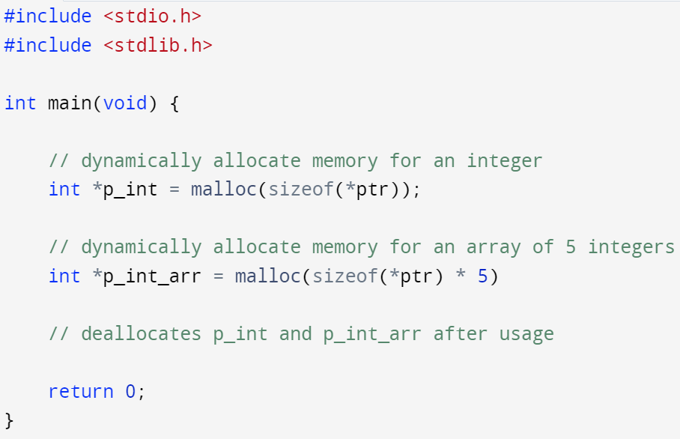
Dynamic Memory Allocation – malloc()
Need to #include <stdlib.h>
void * malloc(size_t size);
size is an integer specifying number of bytes of memory to allocate
Allocates memory
Returns a void pointer type value
Return NULL if malloc fails (no more free memory to allocate)
int *ptr;
free(p_int); free(p_int_arr);

Slide 12
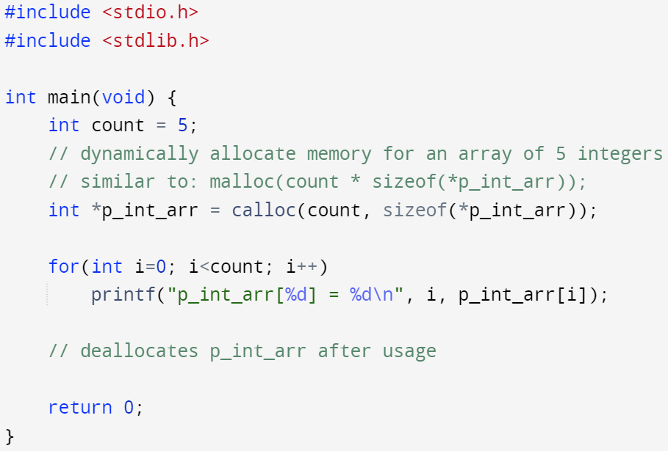
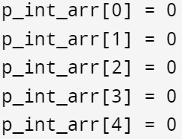
Dynamic Memory Allocation – calloc()
Need to #include <stdlib.h>
void * calloc(size_t nmemb, size_t size);
nmemb is the number of members
size is an integer specifying number of bytes of memory to allocate per member
Allocates memory for nmemb members, each with size bytes
Initialize every byte of allocated memory to 0 (main difference to malloc())
Returns a void pointer type value
Return NULL if calloc fails (no more free memory to allocate)
free(p_int_arr);

Slide 13
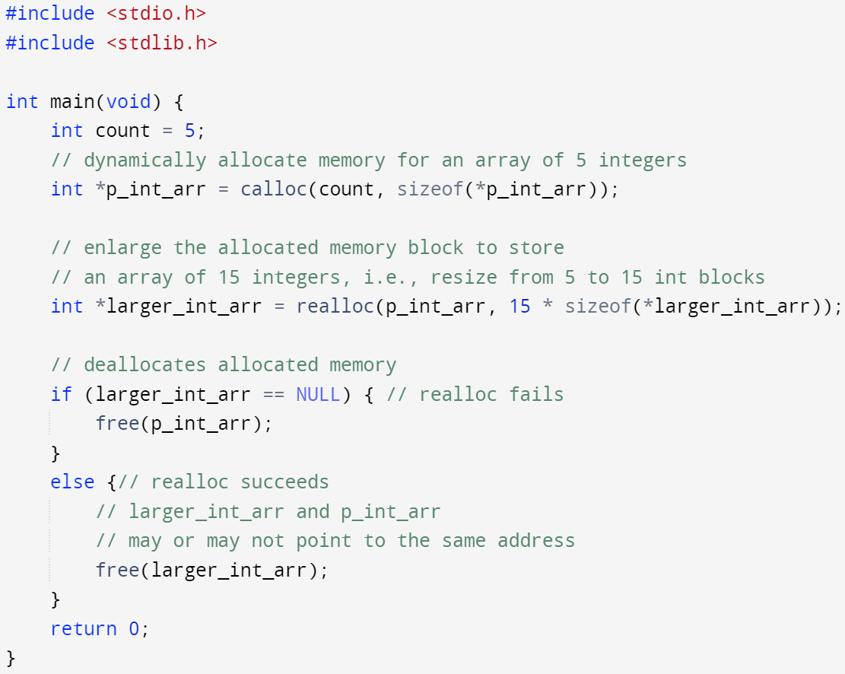
Dynamic Memory Allocation – realloc()
Need to #include <stdlib.h>
void * realloc(void *ptr, size_t size);
Resizes an already dynallocally allocated memory block
ptr must be the starting address of a memory block allocated by malloc() or calloc()
2nd paramemter size is the new size of the memory block after resize, it can be smaller (truncation) or bigger (newly added memory block is not initialized) than the original size
Realloc() might free input ptr pointer and return a new address
Returns a void pointer type value
Return NULL if realloc fails (no more free memory to allocate), the old memory block and the data stored in it is preserved, but the returned void pointer is NULL

Slide 14
Dynamic Memory Allocation – coding conventions
Try to avoid:
Do this if you can:
unnecessary
Error prone: easy to forget
Switch type keyword from int to double without any error
Dereference number returns a value of the pointed type (int) -> sizeof(int): number of bytes of int typed value
Dereference number returns a value of the pointed type (double) -> sizeof(double): number of bytes of double typed value

Slide 15
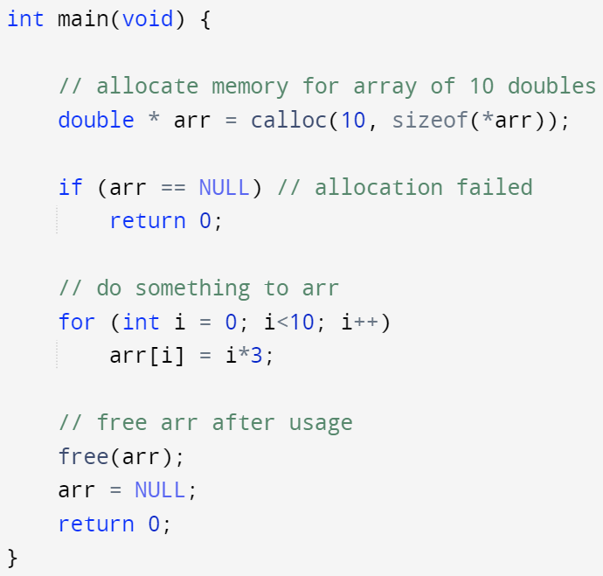
Dynamic Memory Allocation – coding conventions
Pair each malloc()/calloc() call with a call to free() somewhere in your program to deallocate the associated memory block
free(ptr): if ptr == NULL, no action occurs
Remember, malloc/calloc/realloc may fail due to limited memory in runtime.
Check if the returned address is NULL
If it’s NULL, memory allocation failed
You need to do sth when allocation fails

Slide 16
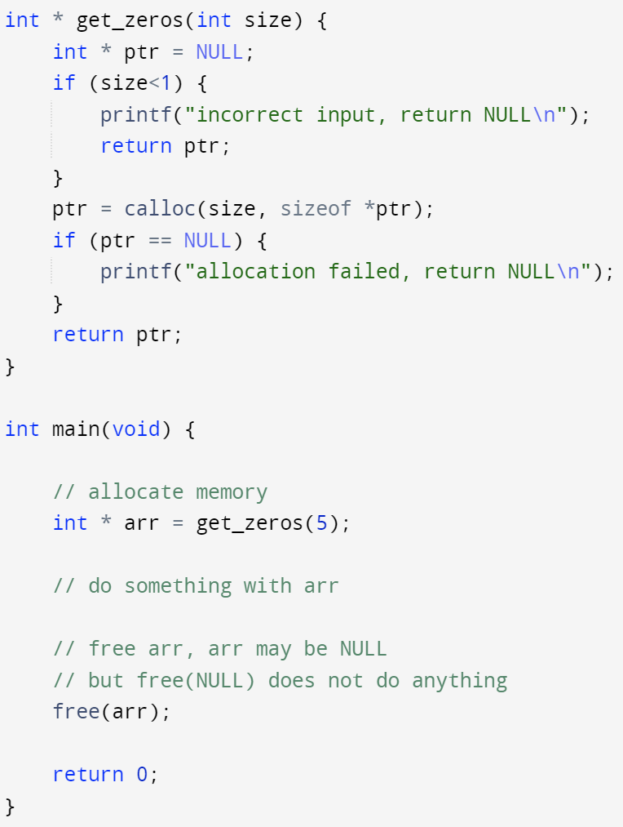
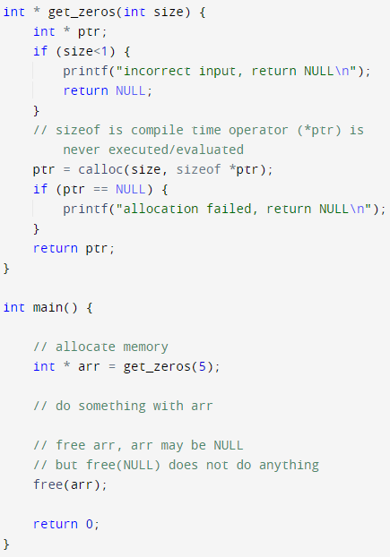
Dynamic Memory Allocation – coding conventions
Pair each malloc()/calloc() call with a call to free() somewhere in your program to deallocate the associated memory block
free(ptr): if ptr == NULL, no action occurs
Remember, malloc/calloc/realloc may fail due to limited memory in runtime.
Check if the returned address is NULL
If it’s NULL, memory allocation failed
You need to do sth when allocation fails

Slide 17
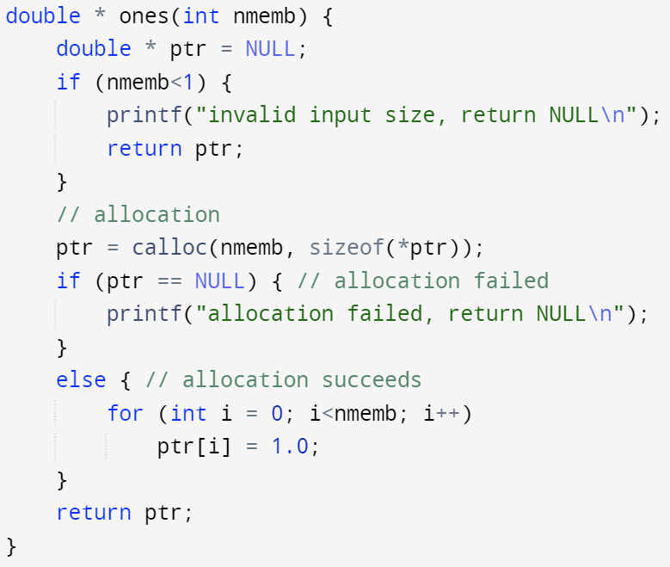
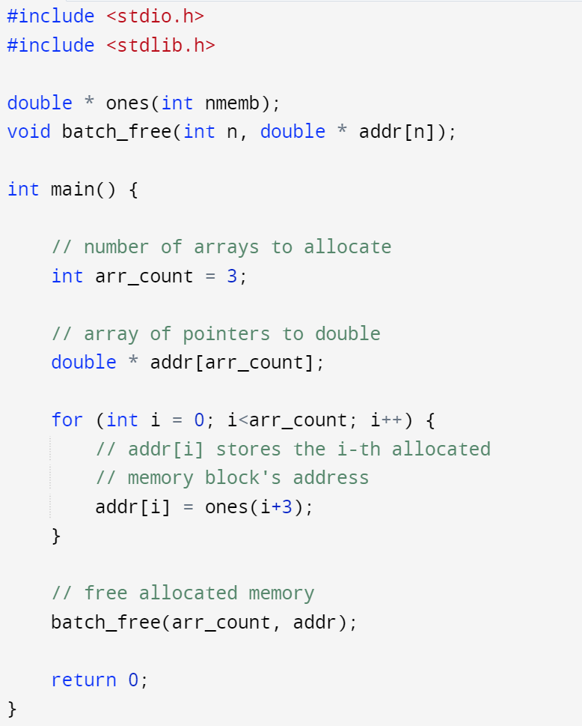
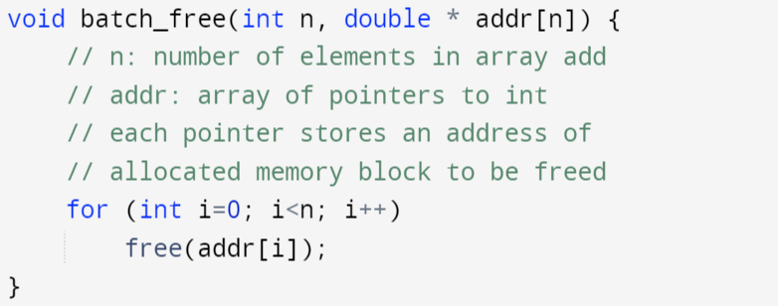
Dynamic Memory Allocation – examples
Function ones() return a pointer to the 1st element of an array of double typed 1s, this array is stored in memory allocated to heap segment
Function batch_free() takes an array of pointers, each pointer stores an address of allocated memory block. This function frees allocated memory blocks in a batch fashion

Slide 18
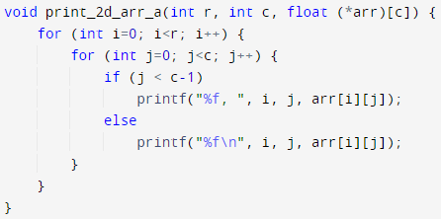
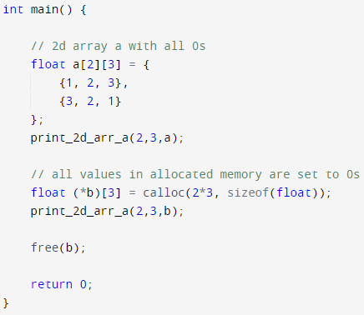

Dynamic Memory Allocation – multi-dimensional Arrays
Recall: multi-dimensional arrays still occupy consecutive blocks of memory from C’s perspective
We can allocate a consecutive block of memory via malloc/calloc
Interpret the allocated memory as if it’s saving a multi-dimensional array
Implicit type casting of the allocated memory address “void *” to “float (*)[3]”

Slide 19
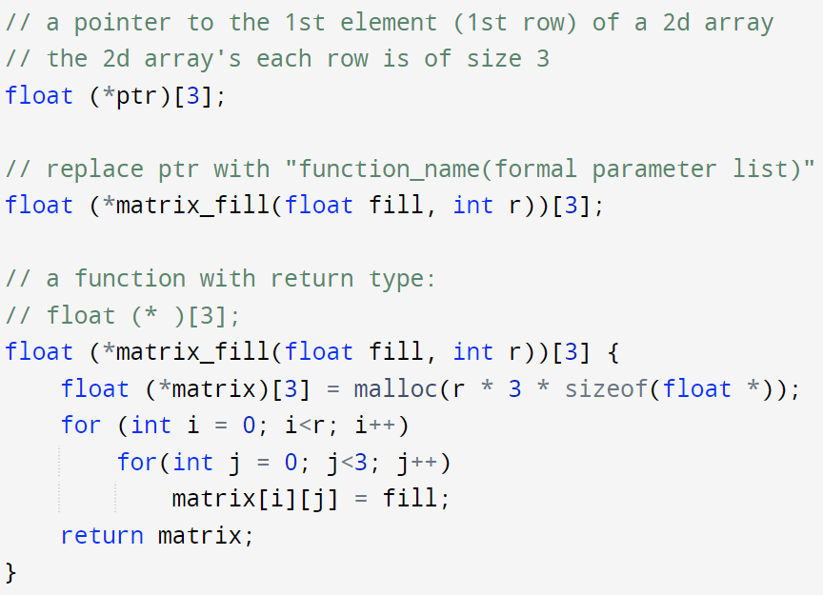
Dynamic Memory Allocation – multi-dimensional Arrays
A function that returns a multi-dimensional array of specified size?
What’s the return type of such a function?
float (* )[3];
a pointer to a whole 1d array of size 3;
Issue with such implementation
The size of the multi-dimensional array is limited (all dimensions other than the 1st dimension must be given as constant)
e.g., column size is hard-coded as 3
can’t add a column formal parameter to deal with this issue, since col in the formal parameter list is in function prototype scope, but [col] is outside of the prototype scope

Slide 20
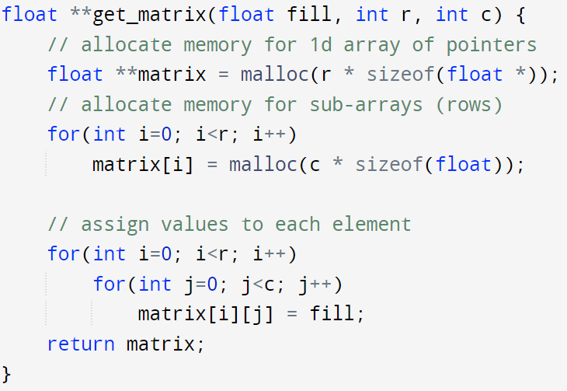
Dynamic Memory Allocation – multi-dimensional Arrays
Use a (multi-dimensional) array of pointers to store address of 1d arrays of the last dimension
This is not actually a 2d array, since the data stored in the memory are not in one consecutive block from C’s perspective
Matrix[0]
float 0
float 1
float 2
…
float c-1
Matrix[1]
Matrix[2]
float 0
float 1
float 2
…
float c-1
…
Matrix[r-1]
float 0
float 1
float 2
…
float c-1
…
float 0
float 1
float 2
…
float c-1

Slide 21
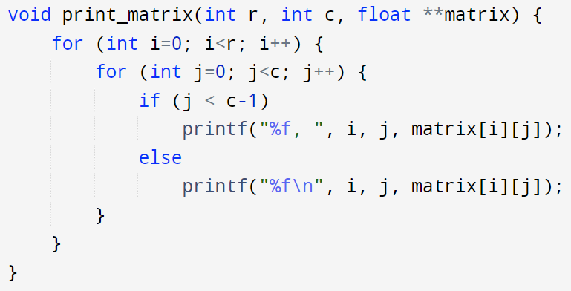
Dynamic Memory Allocation – multi-dimensional Arrays
Our previous print function for 2d array won’t work if the ‘array’ is returned by the function shown in previous slide (double pointer example)
For 2d float data stored in a 1d array of pointers, each pointer points to a 1d float array
For actual 2d float array input
arr[i][j] = *( *(arr + i) + j )
arr + i will increase the address stored in arr by i * sizeof (float[c]), since arr is of float (*)[3] type, it’s pointing to a whole 1d array of 3 float values
matrix[i][j] = *( *(matrix + i) +j )
matrix + i will increase the address stored in matrix by i * sizeof (float *), since matrix is of float ** type, it’s pointing to a single pointer which points to 1 float value

Slide 22
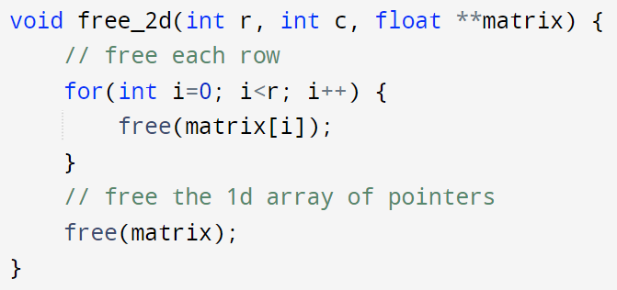
Dynamic Memory Allocation – multi-dimensional Arrays
How to deallocate a 2d array represented by double pointer?
We need to pair each call of malloc/calloc with a free
In previous example, we called malloc r + 1 times
1 time for allocating memory for 1d array of pointers
r times inside the for-loop, one call for each row
r times
1 times
Free the inner most allocation first (matrix[i]), then the outer allocation. As we need the outer allocation (matrix) to find the address of inner allocations (matrix[i])

Slide 23
Memory leak
Memory leak occurs when the program allocates memory via malloc/calloc but does not free the memory before the whole program terminates
The OS keeps track of all the allocated memory to a process, and will free them when that program terminates
If your program keeps running and leaking memory in a cumulative fashion, you may run out of memory before the program terminates
E.g., some program runs on a server for years without termination
We can use valgrind to debug memory related errors

Slide 24
Memory leak - example
Allocate memory to represent a 2d array with double pointer
r times
free(matrix); 1 times
Free the inner most allocation first (matrix[i]), then the outer allocation. Leak r * sizeof(float *) bytes of memory after every call of free_2d()

Slide 25
Valgrind Memcheck
The Valgrind tool suite provides a number of debugging and profiling tools that help you make your programs faster and more correct. The most popular among these tools is called Memcheck
Valgrind Memcheck runs your program inside a virtual environment and checks if any errors related to memory access occur:
Using a variable before initializing
Accessing an address after it’s being freed
Freeing the same address twice
Out of bound array indexing
Memory leak
And more
Valgrind Memcheck is a dynamic analysis tool
It can NOT find all bugs, only the ones that actually happened in the valgrind’s virtual environment
E.g., if you have a memory leak bug in a function foo(), but foo() is never called in your program, valgrind won’t find bugs in foo()
Useful resource:
https://valgrind.org/docs/manual/QuickStart.html
https://web.stanford.edu/class/archive/cs/cs107/cs107.1222/resources/valgrind.html
https://www.youtube.com/watch?v=bb1bTJtgXrI

Slide 26
Valgrind Memcheck
Install valgrind on Ubuntu
Compile your program with –g to include debugging information in your executable file (recall that gdb always requires this flag to be turned on)
Run your program under valgrind’s virtual environment
Redirect valgrind’s output to a log file

Slide 27
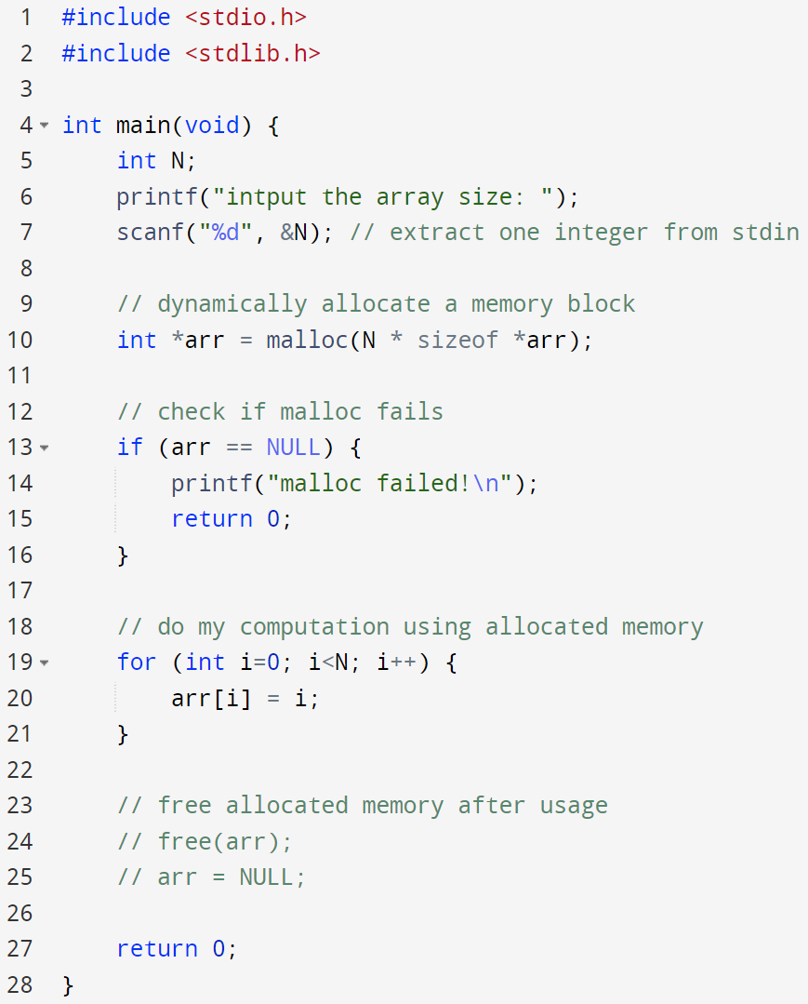
Valgrind Memcheck – example
src.c: dynamic memory allocation at line 10
src.c: missing free() in line 24
Compile the source code with gcc:
Check memory error with valgrind memcheck:

Slide 28
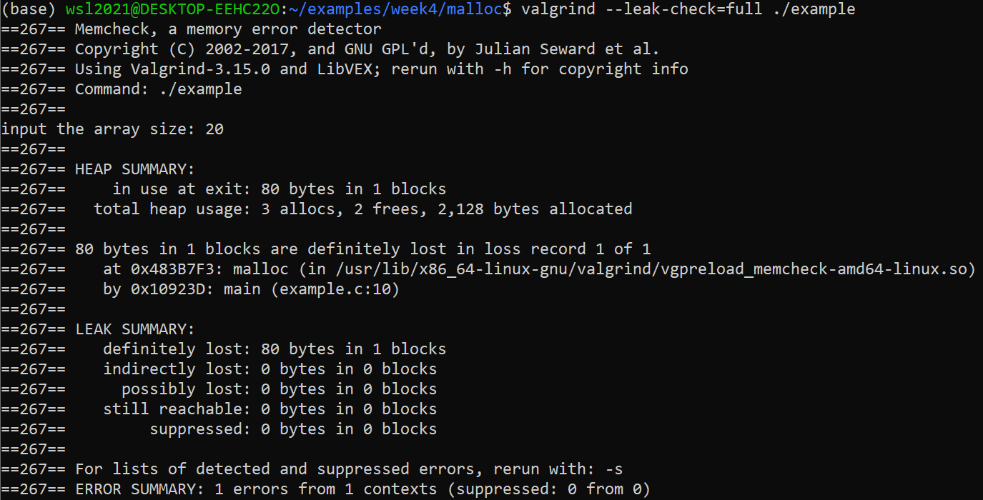
Valgrind Memcheck – example
terminal output:

